Slide 1
College of Criminal Justice

Slide 2
College of Criminal Justice
Academic / Division Departments
Criminal Justice and Criminology
Forensic Science
Security Studies
Victim Studies
Centers
Bill Blackwood LEMIT
Center for Intel. & Crime Analysis
CMIT
Crime Victims Institute
CRIMES/PRC
Inst. Forensic Res. Training Innov.
Institute for Homeland Security
Office for Comp. & Int’l Lead. & Educ.
STAFS (Body Farm)
Et cetera

Slide 3
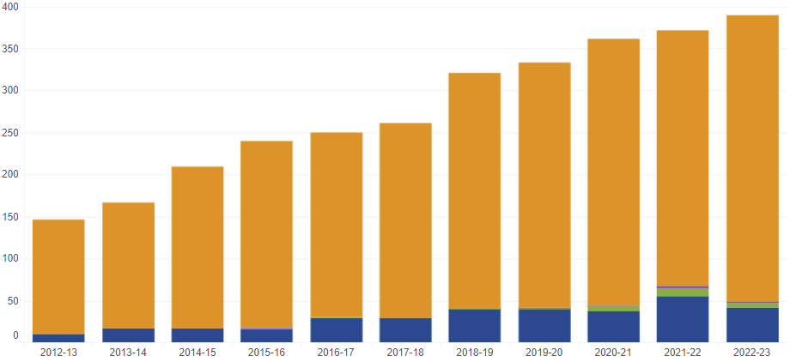
FY 2024 Accomplishments
Priority 1: Prioritize Student Success and Student Access
Expansion of community college and high school pipelines (2,500 CJ majors)
Angelina, Austin, Brownsville ISD, Central Texas, Houston, Miami-Dade, South Plains, Texas Southmost, Temple.
Embedded Associate and B.A.A.S. degree (emphasis Area (for now))
Texas Peace Officer Academic Licensing Academy
Map BPOC to existing courses
Dual Enrollment
U.S. Army M P School collaboration
Continuing HSI Mission
160% increase in degrees conferred

Slide 4
FY 2024 Accomplishments
Priority 2: Embody a Culture of Excellence
Implementation of Premium Distance Learning project
CJ & SS, Asynchronous, Digitally Accessible, 5-wk PoT, OER
Replacing dated content
250% Increase in SCH Fall-to-Fall and Spring-to-Spring
Implementation of new certificate programs to attract new students into both certificate and, eventually, degree programs (optimization)
Crime Analysis (Undergraduate)
Criminal Justice (Undergraduate)
Criminal Justice Management and Leadership (Undergraduate)
Business Security & Resilience (Graduate)
Forensic Science (Undergraduate)

Slide 5
FY 2024 Accomplishments
Priority 3: Elevate the Reputation and Visibility of SHSU
Establishment of Office of Comparative and International Education and Leadership
Reprise annual conference for criminal justice instructors (high school and Community College
Planning video (and paper) newsletters on timely developments in research and law
For criminal justice professionals
For high school and community college instructors
Expansion of our internship program

Slide 6
FY 2024 Accomplishments
Priority 4: Expand and Elevate our Service to the State and Beyond
Installed Senior Executive Director of the Criminal Justice Center
Established Center for Intelligence and Crime Analysis
Expanded Forensic Science M.S. program
Addresses limited forensic science laboratory technician capacity
As per the Texas Legislature
Planning expansion of Southeast Texas Applied Forensic Science facility
Will provide greater service to local, state, and federal criminal justice agencies
As per U.S. Representatives Sessions, Crenshaw, and Luttrell
Developing professional development programming for academic credit (where appropriate)
Elevates practice in the field through promotion of academic certificates and degrees
Starting with: LEMIT, CMIT, CICA, IHS

Slide 7
FY 2025 Keep Doing
Statement: The college plans to keep developing and offering courses in the Premium Distance Learning format because asynchronous distance learning relying on Open Education Resources, accessible on any mobile device, and delivered in five-week parts of term maximizes access for working professionals. This action aligns with prioritizing student success and access through academic agility and will contribute to an increase enrollment of at least 5%.
Supporting Data: Enrollments in the five-week parts of term have increased 250% from Fall ‘22 to Fall ‘23 and from Spring ‘23 to Spring ’24, demonstrating a strong student preference for this format.
Resources / Collaborations Required: Admissions (multiple registration entry points for the corresponding, multiple Parts of Term) Integrated Marketing and Communication (to date, there has been no marketing of the PDL program) SHSU Online (continued course development and ongoing maintenance) The program lacks the necessary infrastructure (to catalog content, integrate scheduling with other courses, hire adjuncts, etc.)

Slide 8
FY 2025 Keep Doing
Statement: The college plans to keep developing cjTexas.org to serve as the go-to CJ resource for Texans because it reinforces our status as the state’s leader in the field. This action aligns with promulgating the SHSU brand in order to elevate the reputation and visibility of SHSU and will contribute to an increase enrollment of at least 5%.
Supporting Data: Both headcount and SCH for our flagship criminal justice and criminology programs are trending down. This points to a compelling need to elevate our reputation and visibility.
Resources / Collaborations Required: Integrated Marketing and Communication (to market the page) Content creator Web-design collaborator (or piggy-back on SHSU’s existing effort)

Slide 9
FY 2025 Stop Doing
Statement: The college plans to stop offering professional development programming without the opportunity to receive academic credit (where appropriate) because doing so overlooks opportunities for our professional development students to leverage their learnings into academic credit. This action aligns with prioritizing student access by recruiting students to drive sustainable growth and will contribute to an increased enrollment of at least 5%.
Supporting Data: Only a fraction of the thousands of professional development participants receive academic credit, and almost none of them actually enroll as students.
Resources / Collaborations Recovered: Revenue from lost enrollments

Slide 10
FY 2025 Stop Doing
Statement: The college plans to stop delivering professional development programs exclusively face-to-face if online instruction is more effective and/or efficient because doing so not only limits the reach of those programs, but also precludes these students from fully leveraging their learnings into academic credit. This action aligns with prioritizing student access through academic agility (flexible modality) and will contribute to an increase in headcount of students enrolled in online and hybrid professional development programming.
Supporting Data: Only a fraction of the thousands of professional development participants receive academic credit, and almost none of them actually enroll as students.
Resources / Collaborations Recovered: Revenue from lost enrollments

Slide 11
FY 2025 Stop Doing
Statement: The division/college plans to stop relying exclusively on the generalized recruiting efforts offered centrally because doing so not only overlooks post-traditional students but also fails to leverage the unique reputation the college has within the state and region and the recruiting opportunities that inhere therefrom. This action aligns with prioritizing student access through better alignment of processes and resources and will contribute to an increased enrollment of at least 5%.
Supporting Data: There has not yet been a marketing/recruiting campaign specific to CJ for working professionals.
Resources / Collaborations Recovered: Revenue lost from failure to market segmentally

Slide 12
FY 2025 Start Doing
Statement: The college plans to start offering an annual conference for high school and community college criminal justice instructors to reinforce our status as the criminal justice leader in the state and region and recruit students, albeit indirectly. This action aligns with promulgating the SHSU brand in order to elevate the reputation and visibility of SHSU and will contribute to an increase enrollment of at least 5%.
Supporting Data: Both headcount and SCH for our flagship criminal justice and criminology programs are trending down. This points to a compelling need to elevate our reputation and visibility.
Resources / Collaborations Required: Integrated Marketing and Communication to advertise the event CJ faculty (develop lesson plans and associated instructional content, present at the conference) College of Education (to ensure continuing education credits for participants) Beto conference center University hotel Aramark

Slide 13
College of Criminal Justice
KEEP
Delivering online courses in the Premium Distance Learning format
Developing cjTexas.org
STOP
Professional development without the opportunity for academic credit
Offering professional development courses exclusively Face-to-Face
Relying exclusively on generalized recruitment
START
Hosting an annual conference for criminal justice instructors

Slide 14
Questions?

